Slide 1


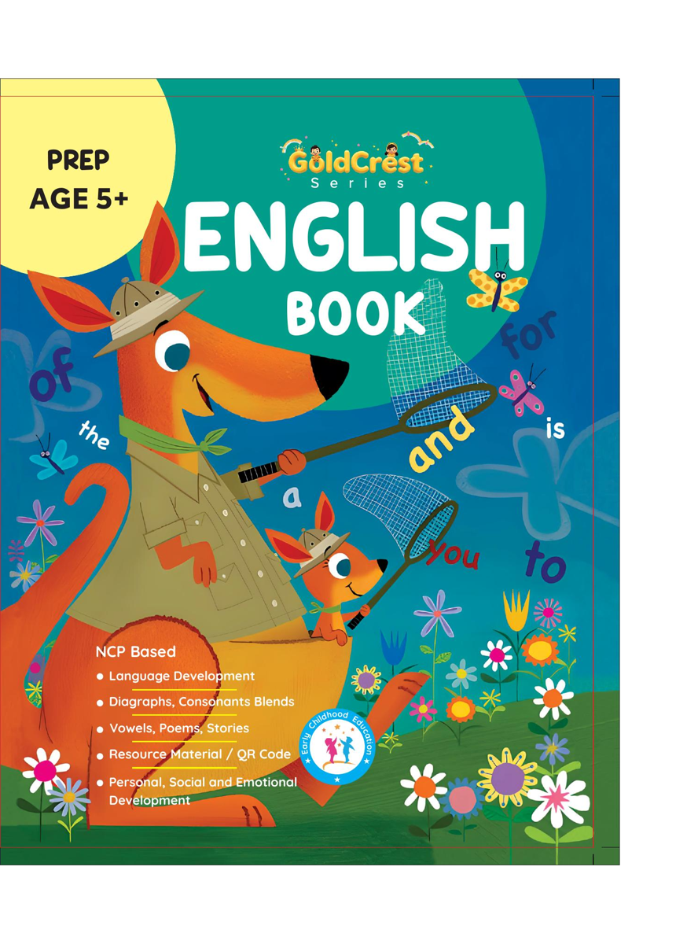
GoldCrest English Book
Prep • Age 5+
An activity-based early-years book from the GoldCrest Series.
A Project of Azhar Publishers & Book Factory

Slide 2
i
What's Inside
GoldCrest English Book Prep • Age 5+
1
Beginning and ending sounds
2
Short and long vowels
3
Digraphs: ch, sh, ph, wh, th
4
Consonant blends
5
Sentence making: a/an, this/that, he/she
6
Stories, rhymes and days of the week

Slide 3
★
Purpose & Classroom Support
Develops reading and simple sentence formation, preparing children for Grade 1 English.
“
Every book comes with
1
2
3
Teacher's Lesson Plan
Practice Papers
Digital Interactive Version
A 40-week lesson plan that guides teachers, day by day.
Monthly tests and term exam papers for children to attempt.
An interactive flipbook and digital exercises for engaging, screen-based practice.
A Project of Azhar Publishers & Book Factory

